Slide 1
Leksell Gamma Knife®
Treatment Statistics Report 1968-2021

Slide 2
Leksell Gamma Knife® TREATMENT STATISTICS CAVEATS
Please reference the Leksell Gamma Knife® Society when using or distributing the data in this presentation and do not hesitate to contact the Secretariat for questions regarding the data on info@lgksociety.com
Making detailed year over year comparisons is not advised due to the annual variability in number of centers reporting. The percent of centers submitting their numbers each year has varied between 68-100% from 1968 to 2021. The rate for 2021 is 68%.
The COVID-19 virus outbreak disrupted life around the globe in 2020. In 2021 the statistics show average treatment volumes are higher than pre-pandemic levels.
1991 reflects cumulative numbers since 1968. Some data contains negative or zero values that cannot be shown in a chart.
Data for specific countries is only provided for those with 6 or more Leksell Gamma Knife® sites.
Due to the format of the annual survey, the reporting of fractionated and staged treatments are mixed.
Year-over-year numbers for certain indications, reflect changes related to alterations in annual reporting methods. The Society has increasingly improved indication-specific reporting to allow for a more refined representation of clinical practice.
In this year’s report and moving forward, we will only include indications with coding in Leksell GammaPlan®. Historical data (pre-2016) and other data sets can be requested from info@lgksociety.com. Examples are as follows:
Aneurysm reported as Other Vascular starting from 2020
Ependymoma, Dysembryoplastic Neuroepithelial Tumor (DNET), Plexomorphic Xanthoastrocytoma (PXA), and Oligodendroglioma, Grade II reported as Other Benign Tumor from 2020
Essential Tremor reported as Other Functional Disorders before 2012
Glioblastoma before 2015 reported as Malignant Glial Tumor (Grade III & IV)
Glomus Tumor and Choroid plexus papilloma reported individually from 2020
Pineal Region Tumor reported by indication type starting from 2020
Malignant Glial Tumor (Grade III & IV) treatments reported by indication from 2015
Meningioma Grade I & II treatments, previously reported separately, reported as Meningioma, All Grades from 2020
Meningioma (anaplastic), grade III, Esthesioneuroblastoma, Hemangiopericytoma (anaplastic) grade III, Solitary Fibrous Tumor, Glomus Tumor, and Hemangiopericytoma, Grade III treatments reported as Other Malignant Tumor from 2020
Metastatic Tumors reported as either single or multiple from 2020
Malignant Tumors are separated to Primary Malignant Tumors and Malignant Metastatic Tumors from 2021
More specific reporting of Epilepsy indications as of 2013
Other Pain Disorders removed from 2020 (Trigeminal Neuralgia, Intractable Pain or Cluster Headache are available)
Squamous cell carcinoma and Adenoid cystic carcinoma reported individually from 2020
From 2021 anaplastic were moved from Benign to Malignant tumors

Slide 3
Leksell Gamma Knife® TABLE OF CONTENTS
Slide # |  | Slide # |  | Slide #
 | GLOBAL STATISTICS REPORTED |  | INDICATION SPECIFIC STATISTICS |  | REGION AND COUNTRY STATISTICS
2 | Treatment statistics caveats | 19-21 | Benign Tumors | 48 | Europe
4 | Cumulative volume 2021 | 22-24 | Functional Disorders | 49 | Cumulative volume
5 | Indications treated annually | 25-27 | Malignant Tumors | 50-52 | Indications treated annually
6 | Change in average volume | 28-30 | Ocular Disorders | 53-54 | Italy
7 | Average treatment volume, models 2021 | 31-33 | Vascular Disorders | 55-56 | Russia
8 | Distribution of treatments, region |  |  | 57-58 | Turkey
9 | Worldwide case mix by year |  | REGION AND COUNTRY STATISTICS | 59-60 | United Kingdom
10 | Case mix by region, cumulative & annual | 35 | Asia
11 | Indications treated cumulative | 36 | Cumulative volume | 61 | Middle East and Africa
12 | Indications treated 2021 | 37-39 | Indications treated annually | 62 | Cumulative volume
13-15 | Case mix by 9 largest markets, 2021 | 40-41 | China | 63-65 | Indications treated annually
16-17 | Fractionated or staged treatments, 2021 | 42-43 | India
 |  | 44-45 | Japan | 66 | The Americas
 |  | 46-47 | Korea | 67 | Cumulative Volume
 |  |  |  | 68-70 | Indications treated annually
 |  |  |  | 71-72 | Canada
 |  |  |  | 73-74 | United States of America
 |  |  |  | 75 | Society membership & statistic information
 |  |  |  | 76 | How to copy slide and keep format

Slide 4
Leksell Gamma Knife® OVER 1 473 000 TREATMENTS REPORTED THROUGH 2021, WORLDWIDE

Slide 5
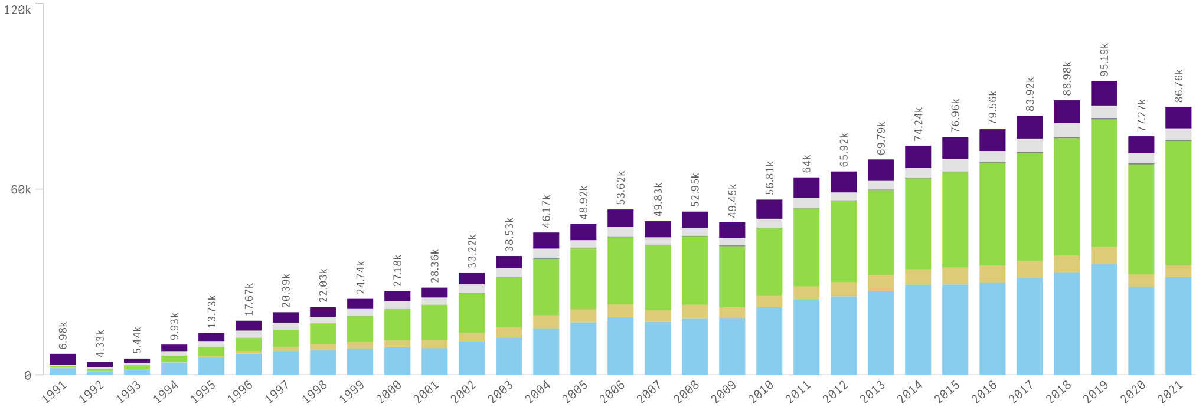
Leksell Gamma Knife® INDICATIONS REPORTED ANNUALLY THROUGH 2021, WORLDWIDE

Slide 6
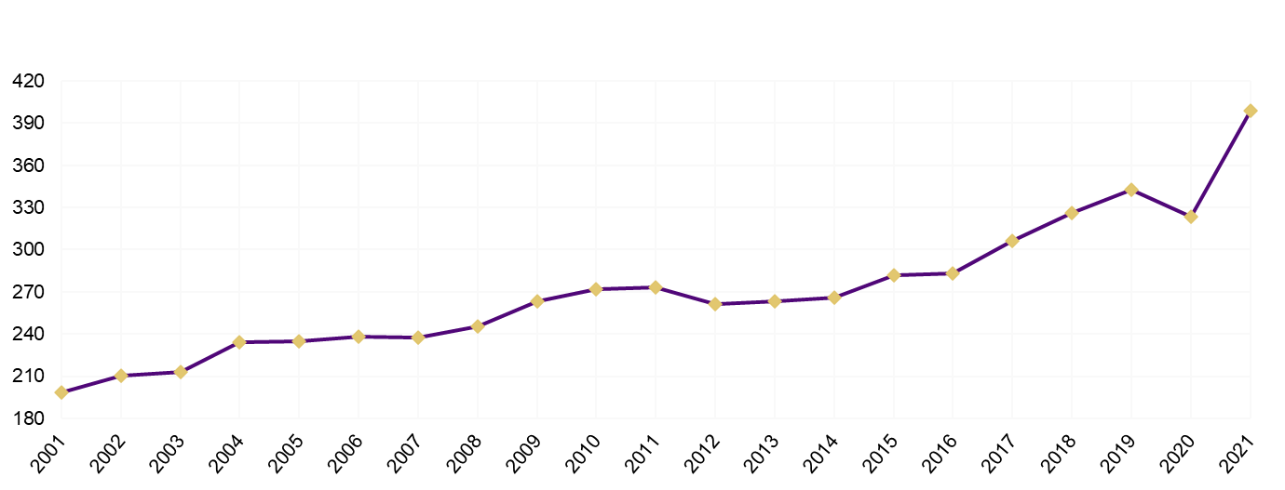
Leksell Gamma Knife® CHANGE IN AVERAGE VOLUME PER REPORTING CENTER, WORLDWIDE

Slide 7
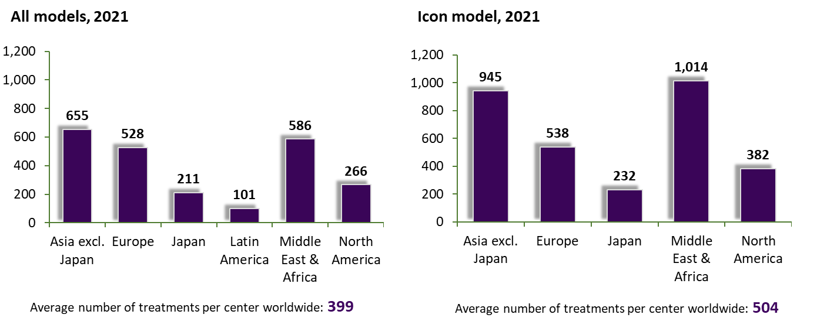
Leksell Gamma Knife® AVERAGE NUMBER OF REPORTED 2021 TREATMENTS PER REGION & CENTER

Slide 8
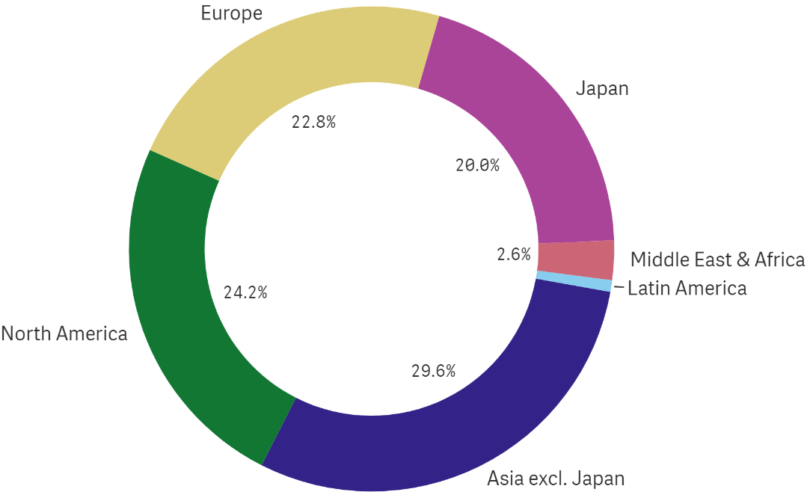
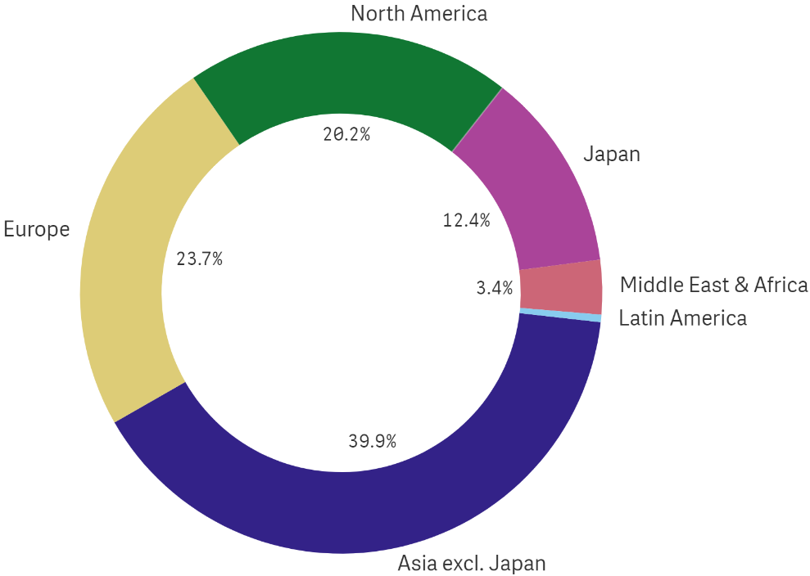
Leksell Gamma Knife® DISTRIBUTION OF REPORTED TREATMENTS BY REGION
1968 – 2021
2021

Slide 9
Leksell Gamma Knife® REPORTED WORLDWIDE CASE MIX BY YEAR

Slide 10
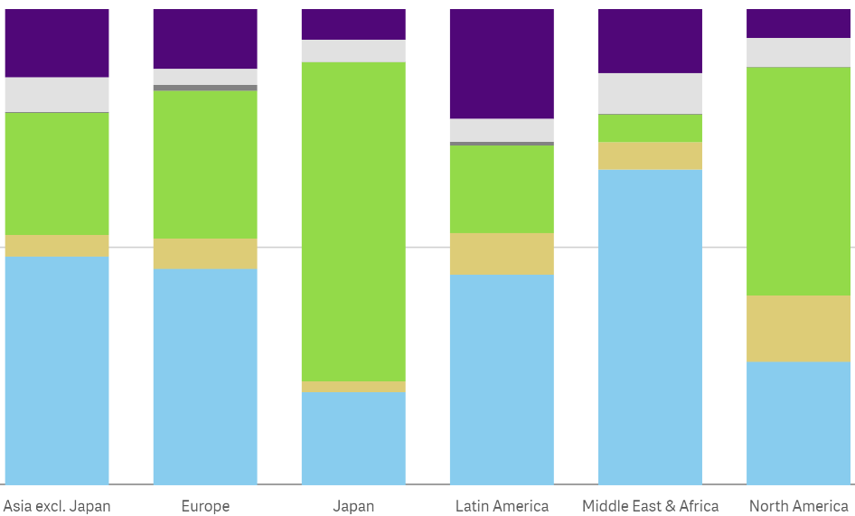
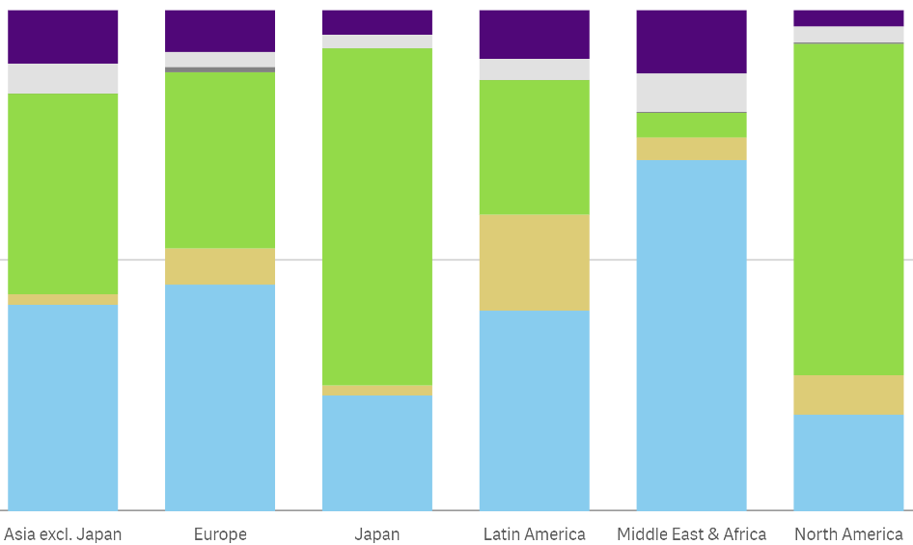
Leksell Gamma Knife® CASE MIX REPORTED BY REGION – CUMULATIVE AND ANNUAL
1968 - 2021
2021

Slide 11
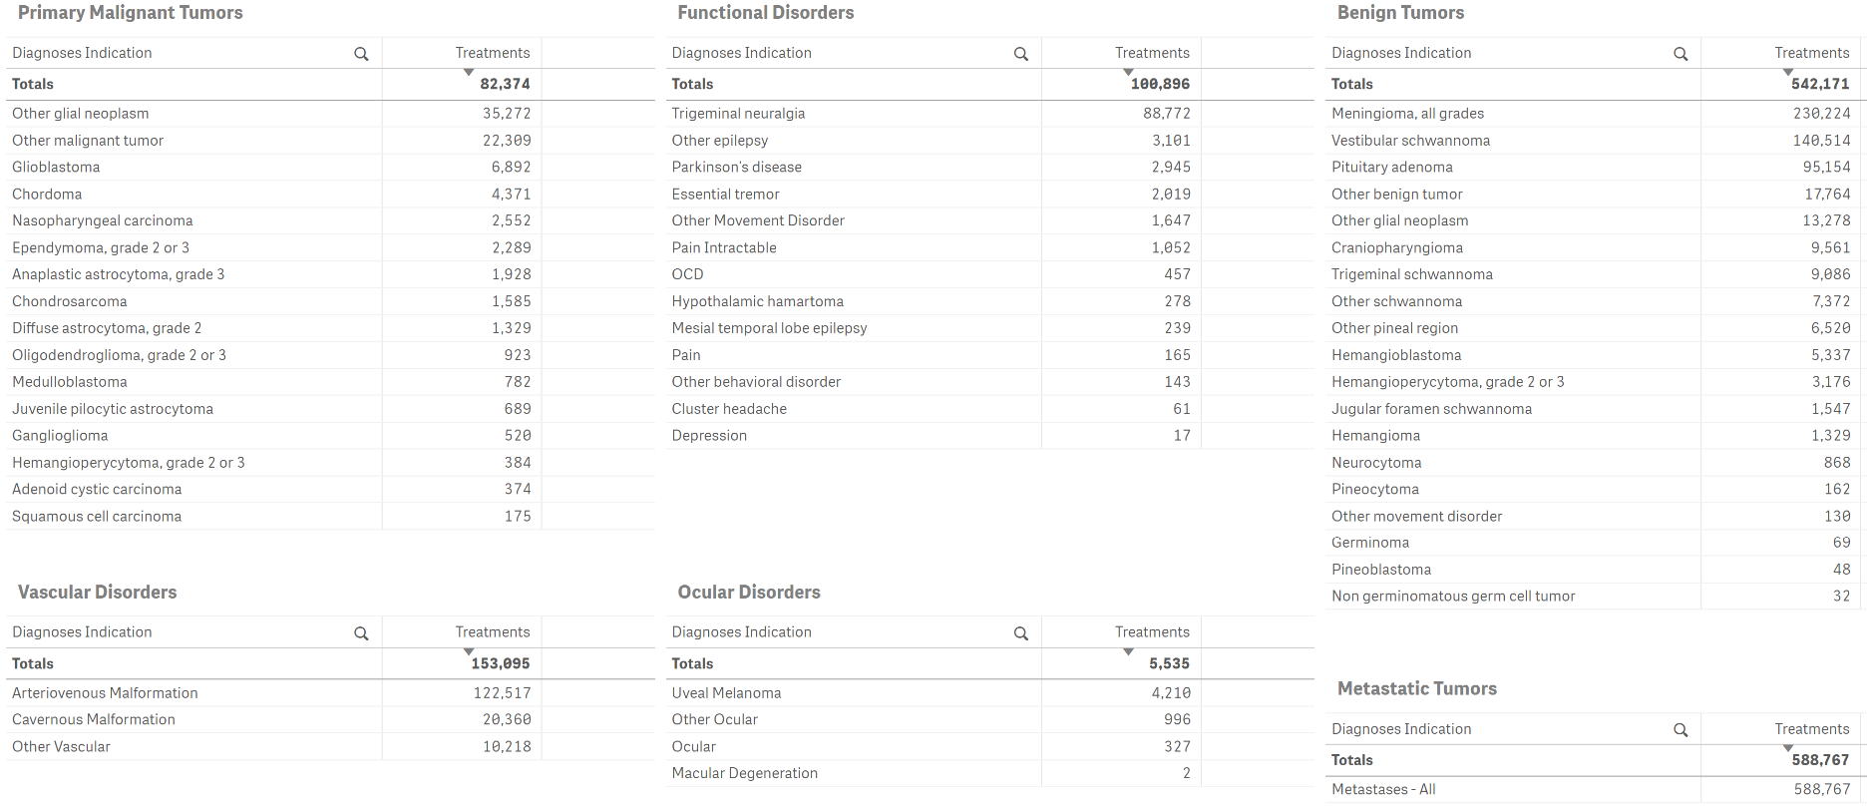
Leksell Gamma Knife® INDICATIONS REPORTED 1968 – 2021, WORLDWIDE

Slide 12
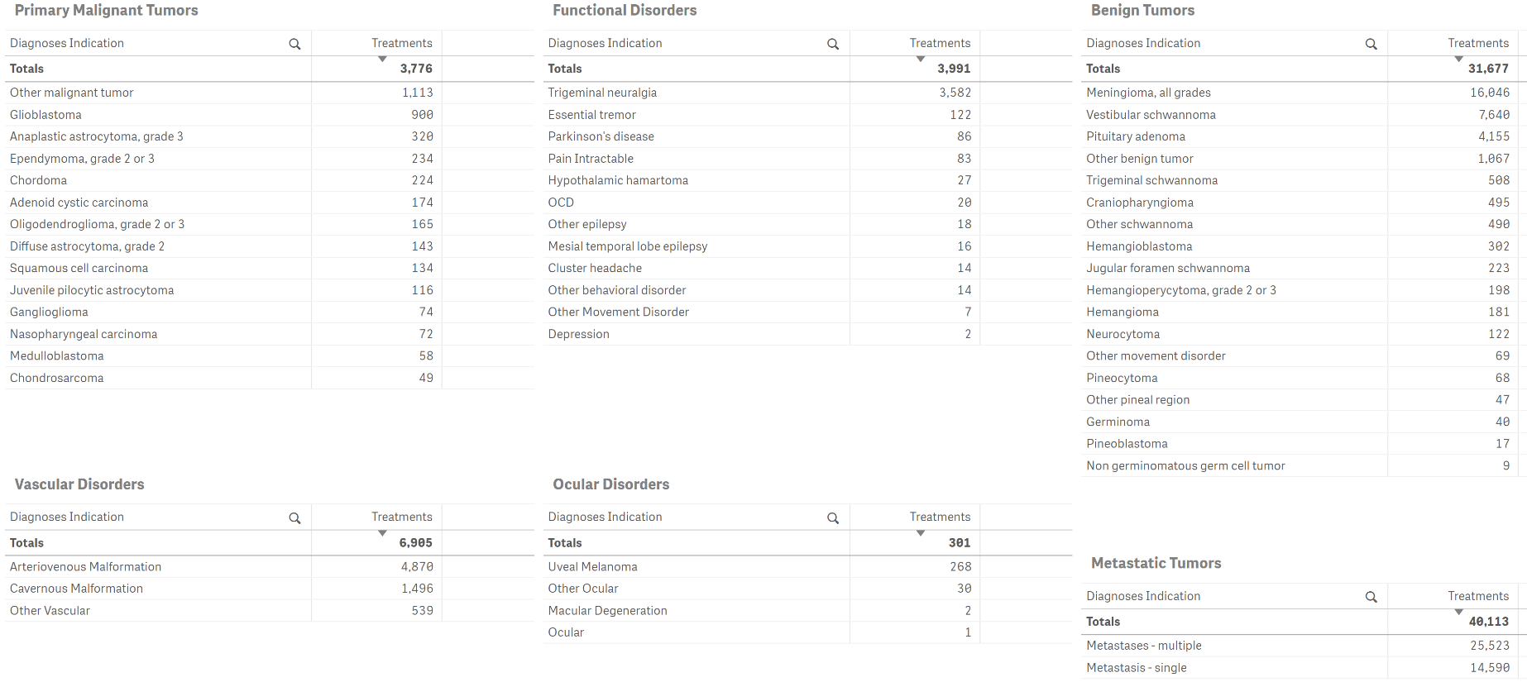
Leksell Gamma Knife® INDICATIONS REPORTED 2021, WORLDWIDE

Slide 13
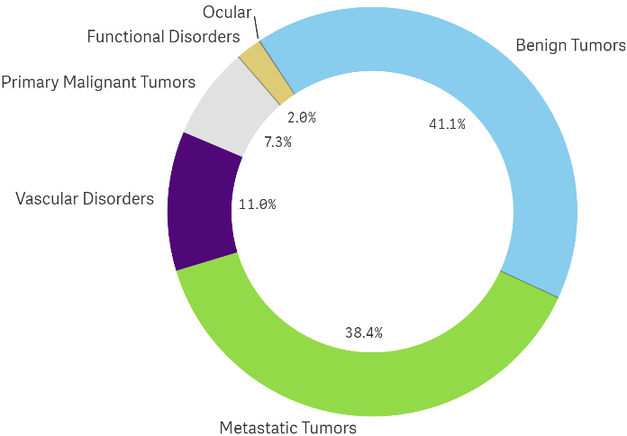
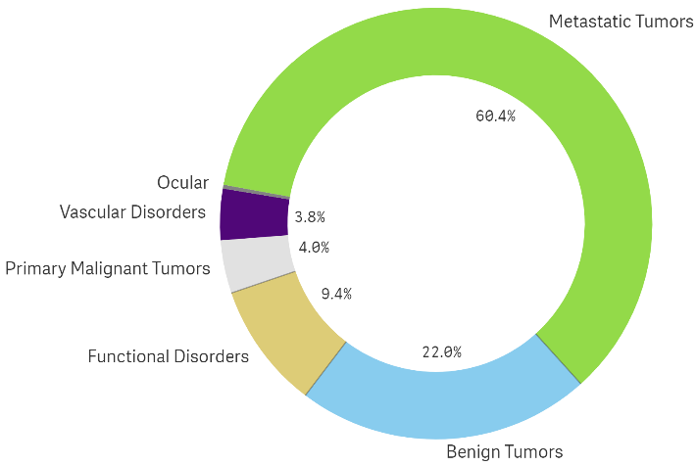
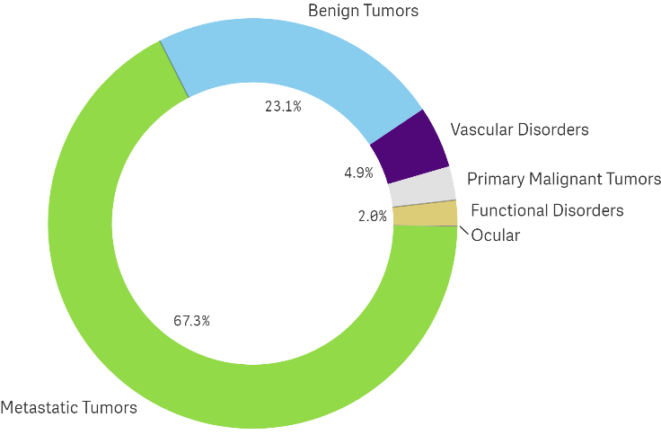
Leksell Gamma Knife® CASE MIX BY COUNTRY 2021, 9 LARGEST MARKETS SORTED BY REPORTED VOLUME (≥ 6 PROGRAMS/COUNTRY)
CHINA
UNITED STATES
JAPAN

Slide 14
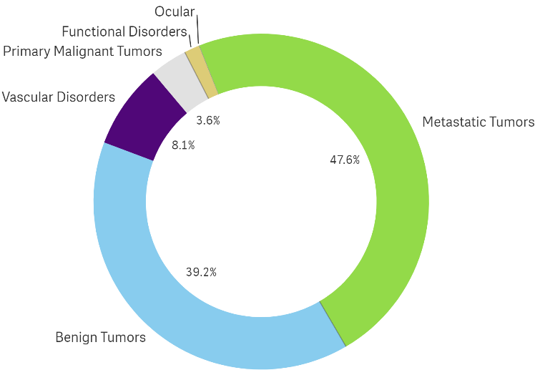
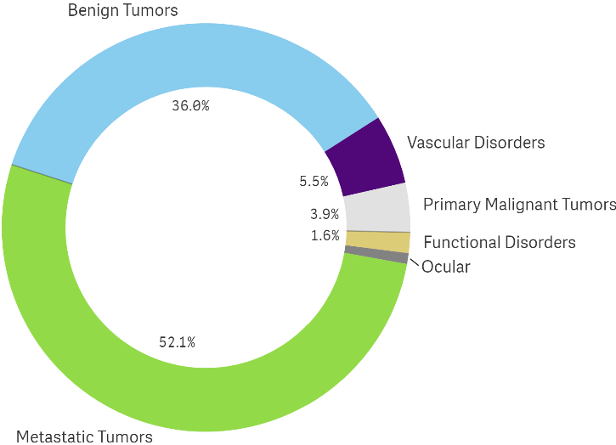
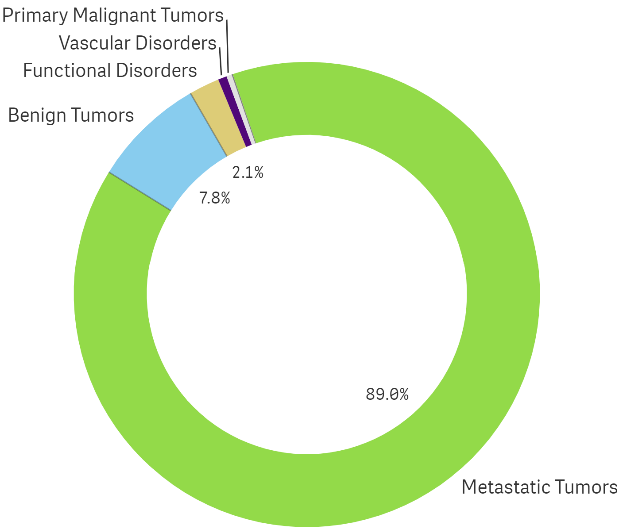
Leksell Gamma Knife® CASE MIX BY COUNTRY 2021, 9 LARGEST MARKETS SORTED BY REPORTED VOLUME (≥ 6 PROGRAMS/COUNTRY)
THE REPUBLIC OF KOREA
RUSSIA
CANADA

Slide 15
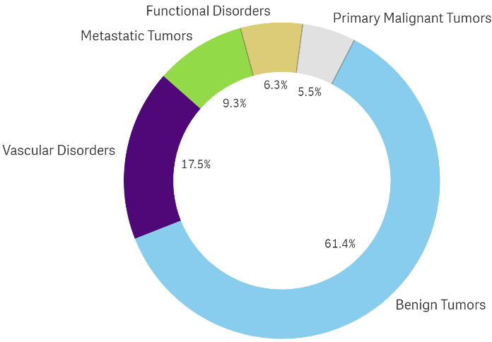
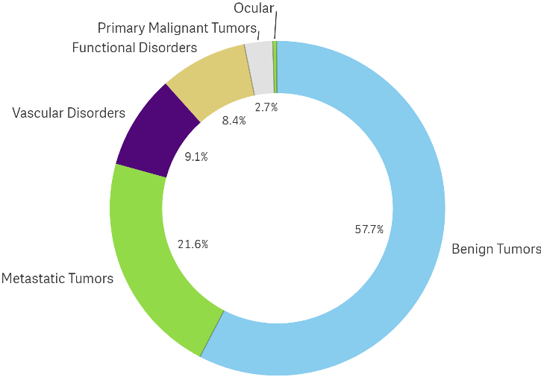
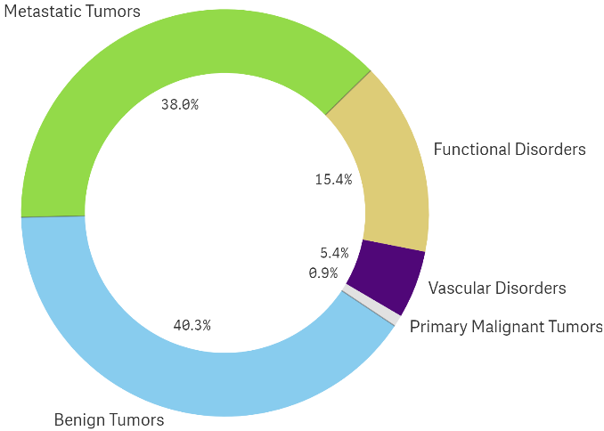
Leksell Gamma Knife® CASE MIX BY COUNTRY 2021, 9 LARGEST MARKETS SORTED BY REPORTED VOLUME (≥ 6 PROGRAMS/COUNTRY)
TURKEY
ITALY
FRANCE

Slide 16
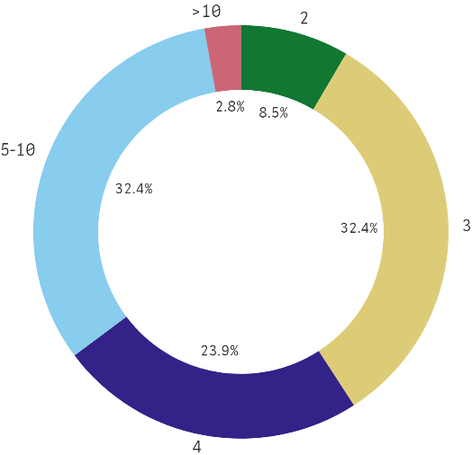
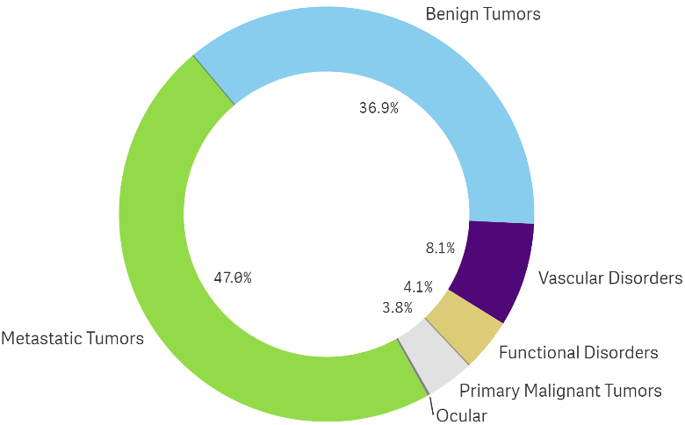
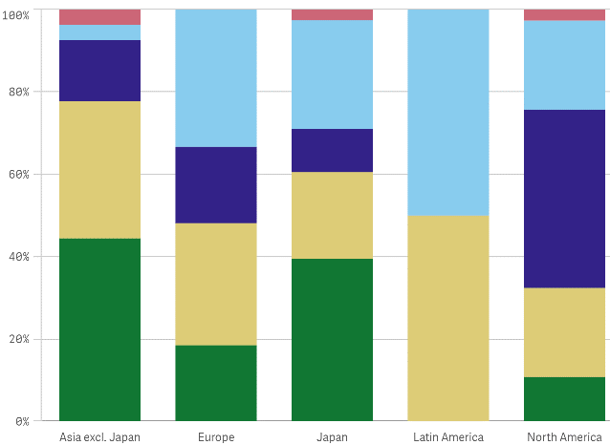
Leksell Gamma Knife® 2021 FRACTIONATED OR STAGED REPORTED TREATMENTS, WORLDWIDE
Global Distribution of Fractions
Fractions Utilized by Region
Indications Treated with Fractionation
*80 centers reported multi-session treatment data in 2021.

Slide 17
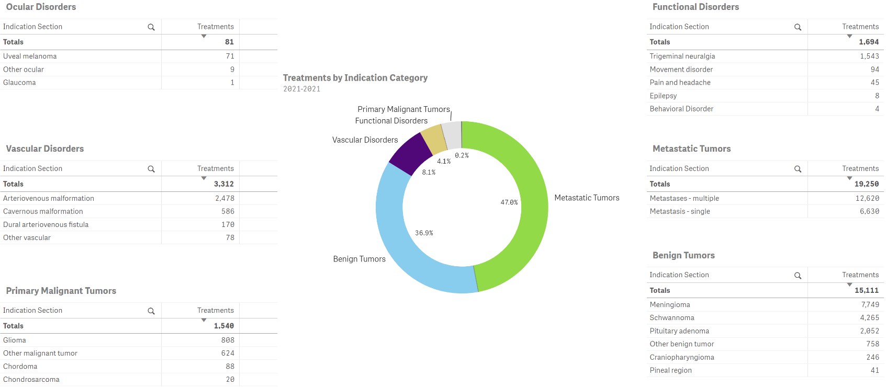
Leksell Gamma Knife® FRACTIONATED OR STAGED REPORTED INDICATIONS 2021, WORLDWIDE
*80 centers reported multi-session treatment data in 2021.
*80 centers reported multi-session treatment data in 2021.

Slide 18
Leksell Gamma Knife® TREATMENTS REPORTED
Indication Specific Statistics 1968 - 2021

Slide 19
Leksell Gamma Knife® BENIGN TUMORS CUMULATIVE TREATMENTS REPORTED WORLDWIDE 1968 – 2021

Slide 20
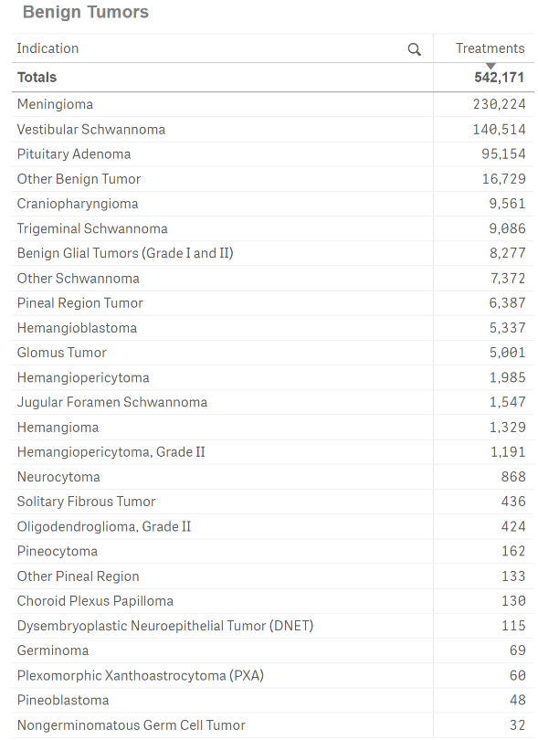
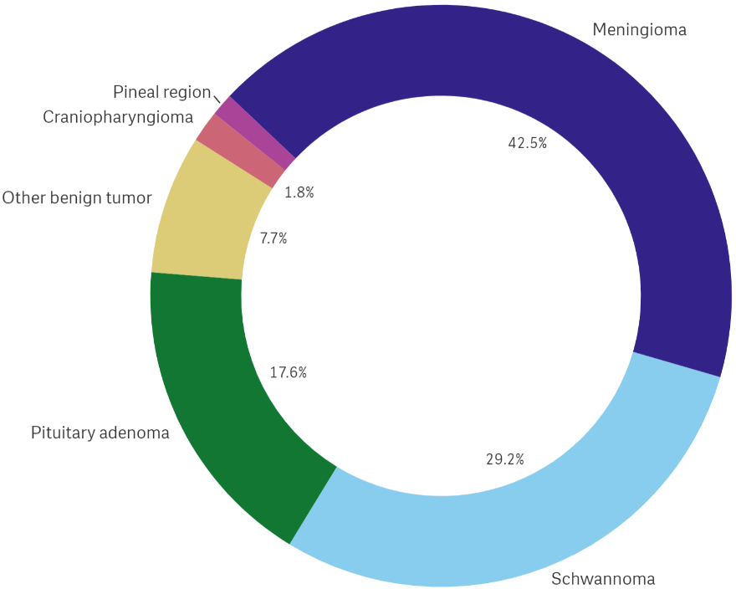
Leksell Gamma Knife® BENIGN TUMORS REPORTED WORLDWIDE 1968 – 2021

Slide 21
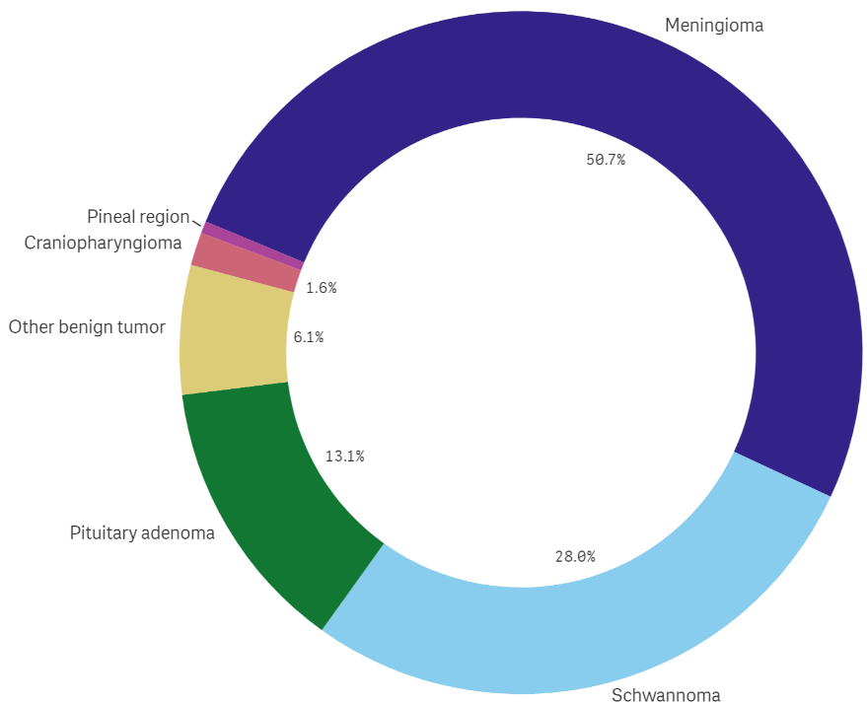
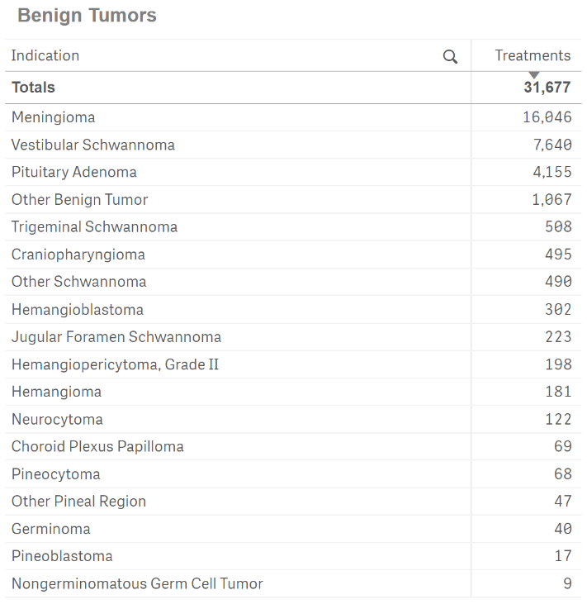
Leksell Gamma Knife® BENIGN TUMORS REPORTED WORLDWIDE 2021

Slide 22
Leksell Gamma Knife® FUNCTIONAL DISORDERS CUMULATIVE TREATMENTS REPORTED WORLDWIDE 1968 – 2021

Slide 23
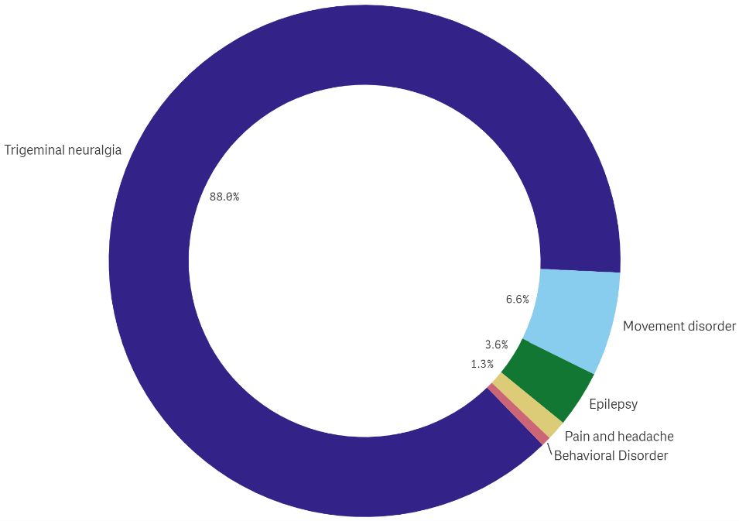
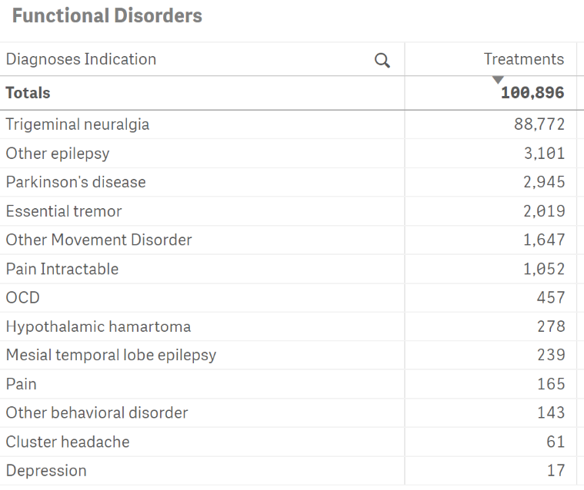
Leksell Gamma Knife® FUNCTIONAL DISORDERS REPORTED WORLDWIDE 1968 - 2021

Slide 24
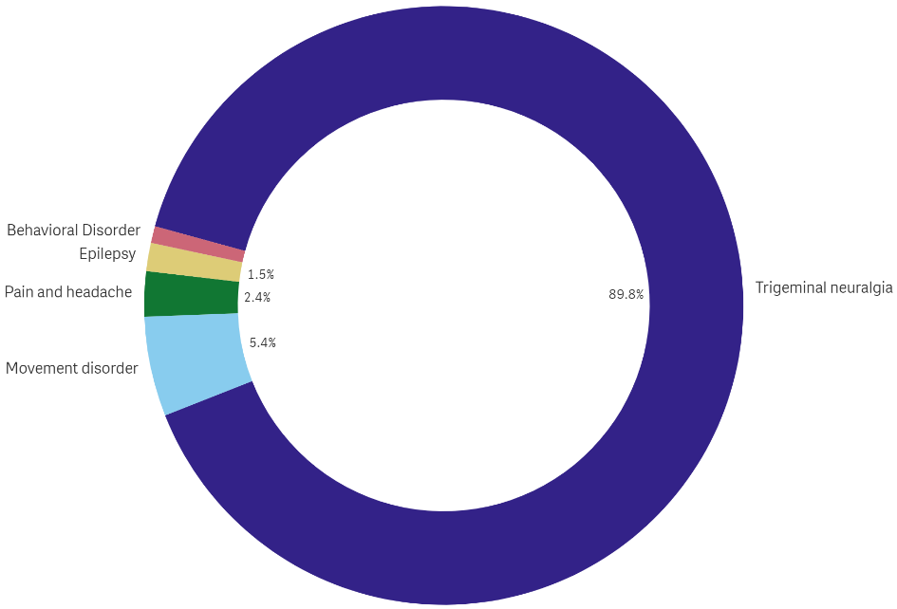
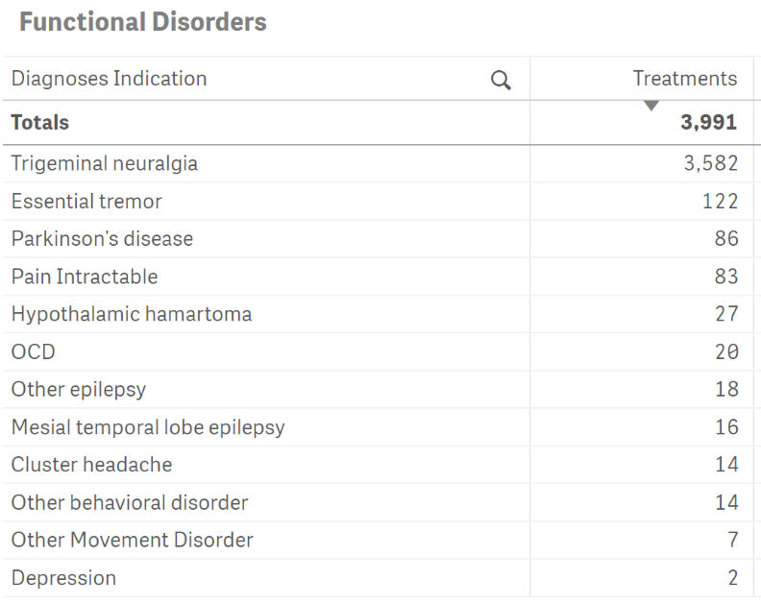
Leksell Gamma Knife® FUNCTIONAL DISORDERS REPORTED WORLDWIDE 2021
Functional Indications

Slide 25
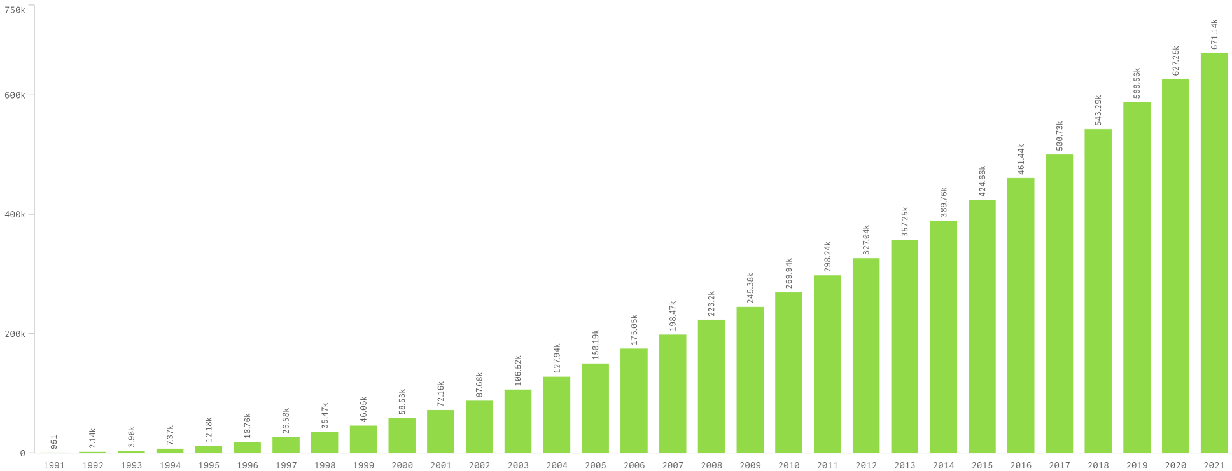
Leksell Gamma Knife® PRIMARY MALIGNANT AND METASTATIC TUMORS CUMULATIVE TREATMENTS REPORTED WORLDWIDE

Slide 26
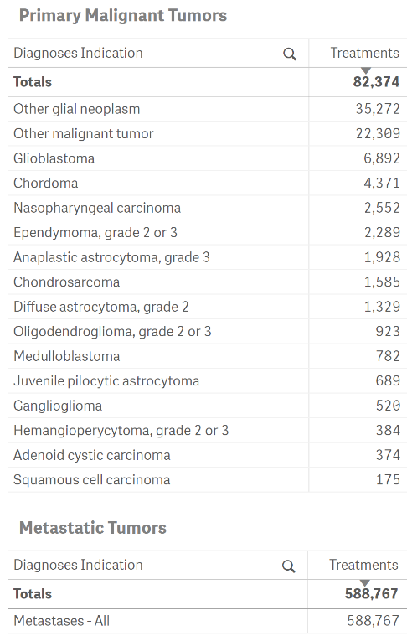
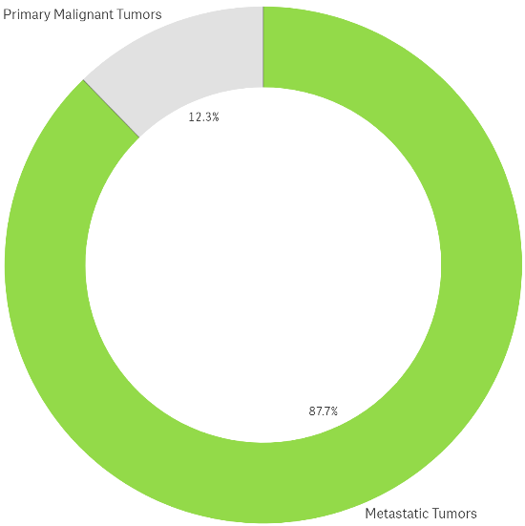
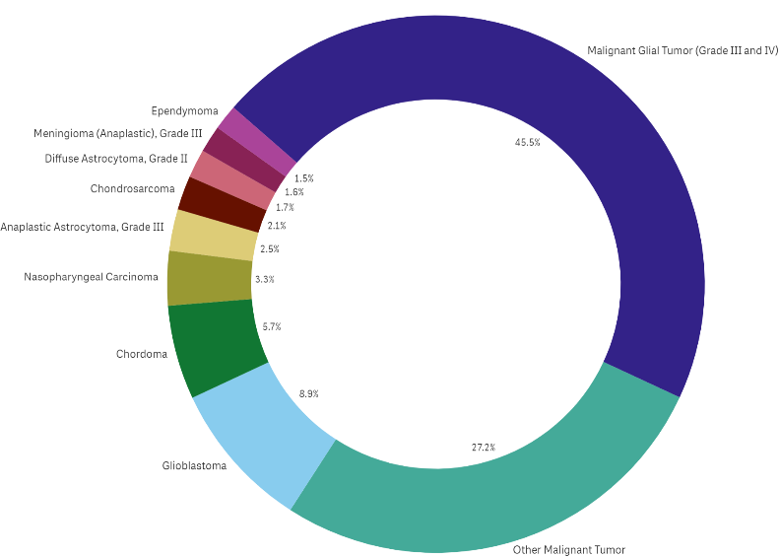
Leksell Gamma Knife® PRIMARY MALIGNANT AND METASTATIC TUMORS REPORTED WORLDWIDE 1968 – 2021
All Malignant
Malignant Indications
Primary Malignant Excluding Metastatic Tumors

Slide 27
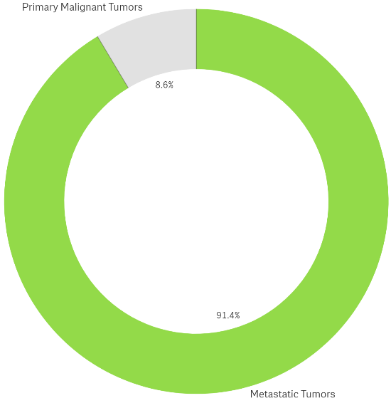
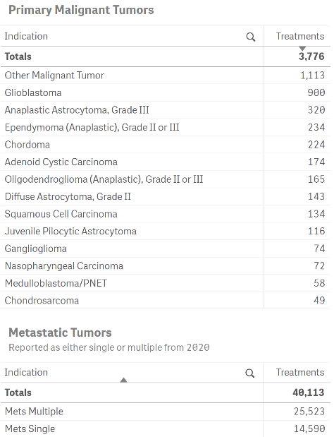
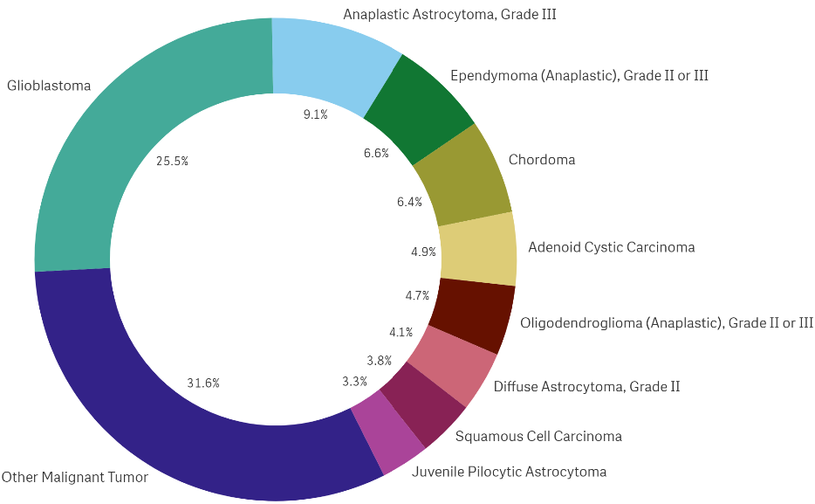
Leksell Gamma Knife® PRIMARY MALIGNANT AND METASTATIC TUMORS REPORTED WORLDWIDE – 2021
All Malignant
Malignant Indications
Primary Malignant Excluding Metastatic Tumors

Slide 28
Leksell Gamma Knife® OCULAR DISORDERS CUMULATIVE TREATMENTS REPORTED WORLDWIDE

Slide 29
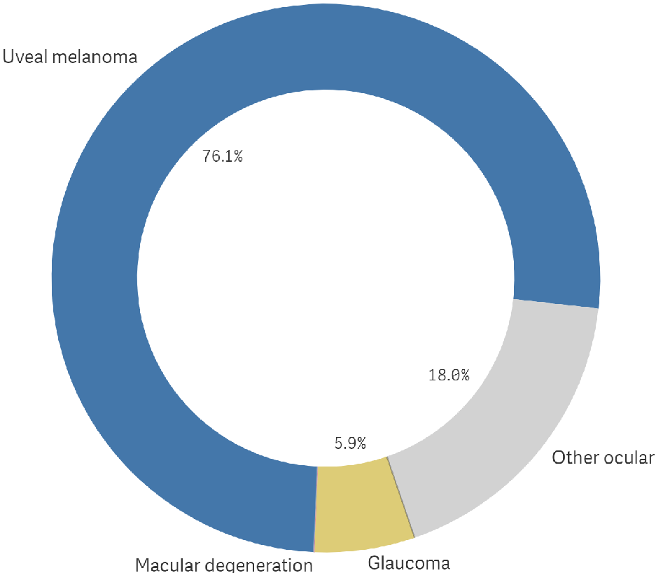
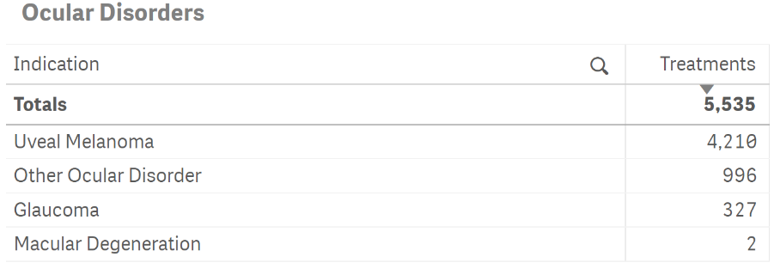
Leksell Gamma Knife® OCULAR DISORDERS REPORTED WORLDWIDE 1968 – 2021

Slide 30
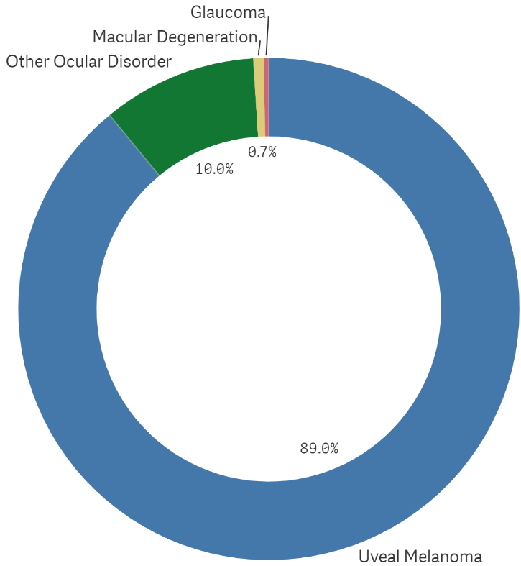
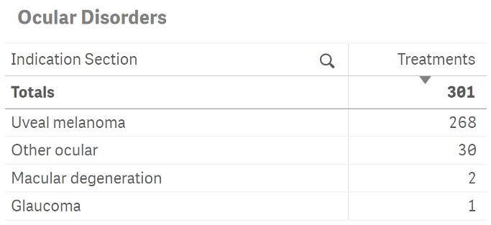
Leksell Gamma Knife® OCULAR DISORDERS REPORTED WORLDWIDE 2021

Slide 31
Leksell Gamma Knife® VASCULAR DISORDERS CUMULATIVE TREATMENTS REPORTED WORLDWIDE

Slide 32
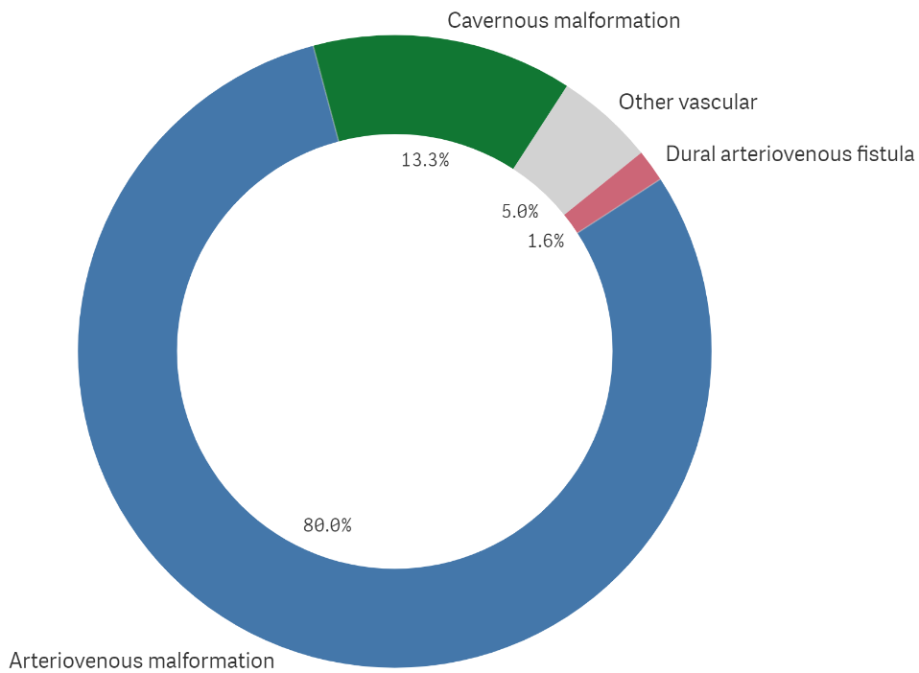
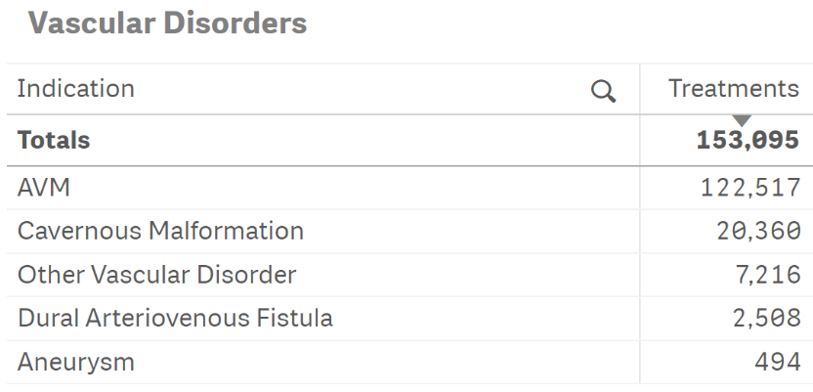
Leksell Gamma Knife® VASCULAR DISORDERS REPORTED WORLDWIDE 1968 – 2021

Slide 33
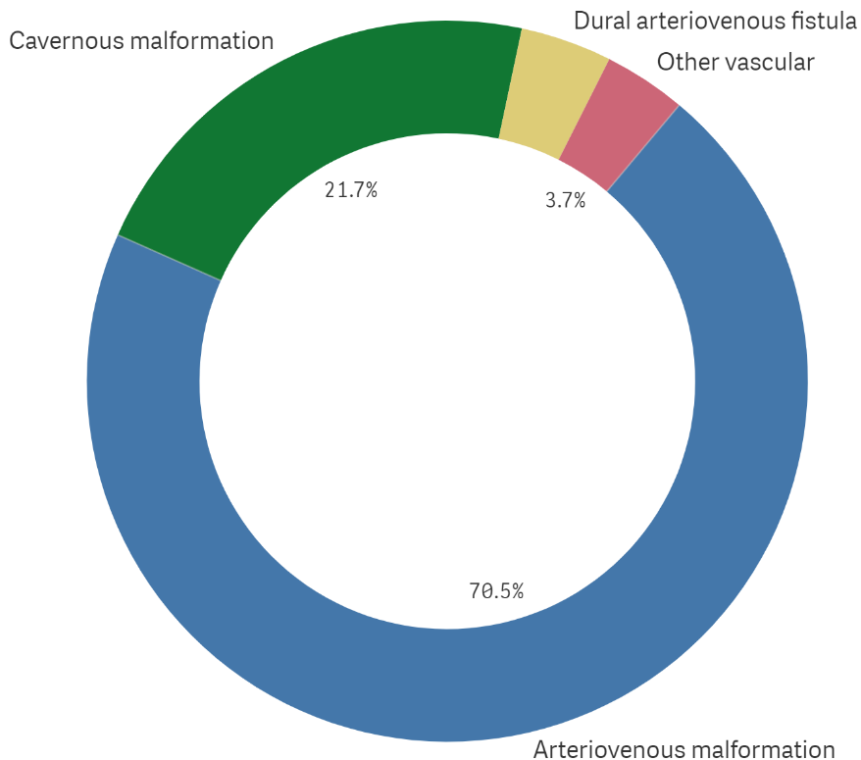
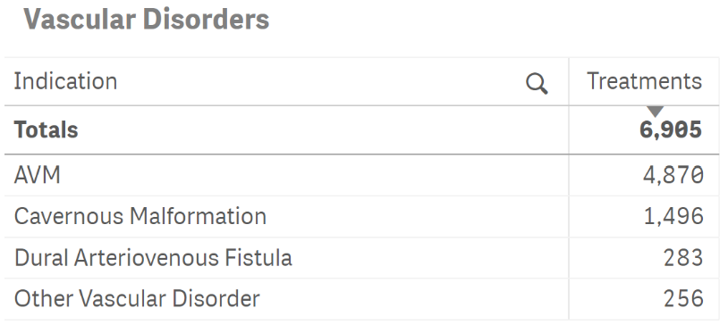
Leksell Gamma Knife® VASCULAR DISORDERS REPORTED WORLDWIDE 2021

Slide 34
Leksell Gamma Knife® TREATMENTS REPORTED
Region & Country Statistics
1968-2021

Slide 35
ASIA

Slide 36
Leksell Gamma Knife® OVER 730 000 TREATMENTS REPORTED THROUGH 2021, ASIA

Slide 37
Leksell Gamma Knife® INDICATIONS REPORTED ANNUALLY, ASIA

Slide 38
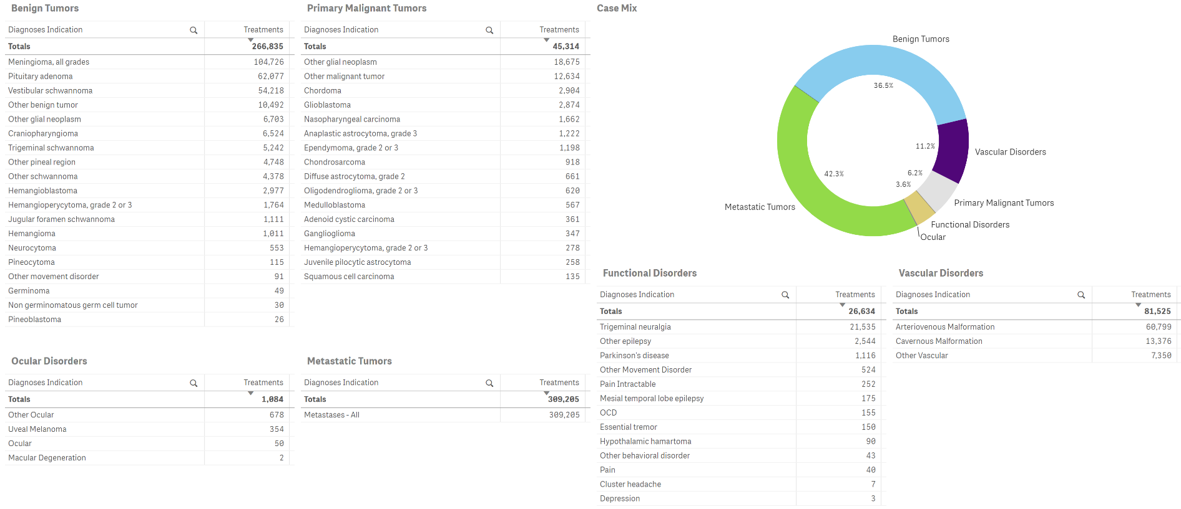
Leksell Gamma Knife® INDICATIONS REPORTED ASIA, 1990 – 2021

Slide 39
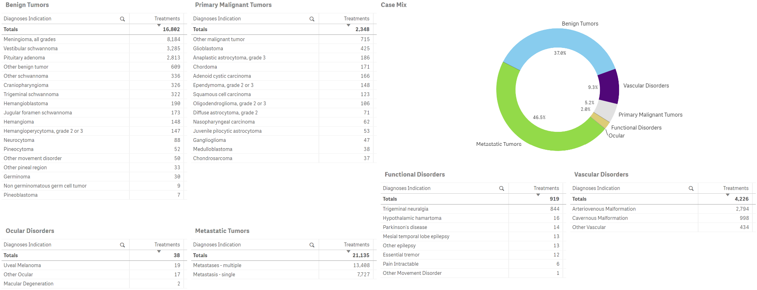
Leksell Gamma Knife® INDICATIONS REPORTED ASIA, 2021

Slide 40
Leksell Gamma Knife® OVER 282 000 TREATMENTS REPORTED THROUGH 2021, CHINA

Slide 41
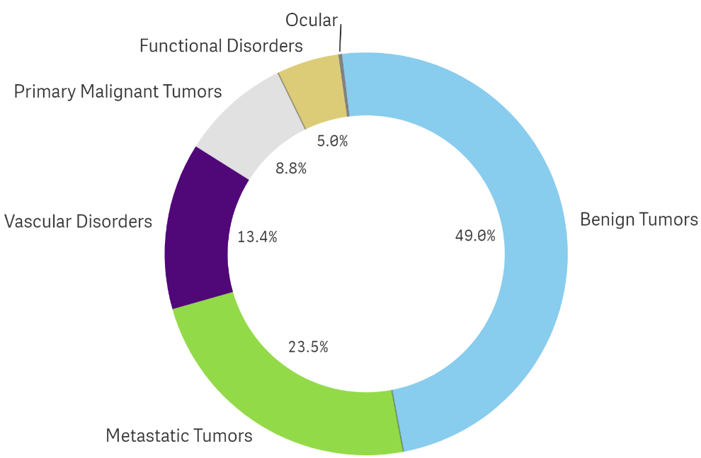
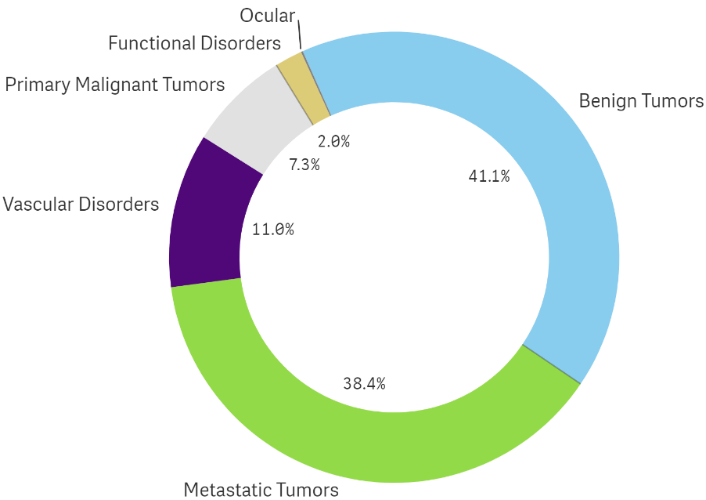
Leksell Gamma Knife® CASE MIX, CHINA
1993 - 2021
2021

Slide 42
Leksell Gamma Knife® OVER 20 000 TREATMENTS REPORTED THROUGH 2021, INDIA

Slide 43
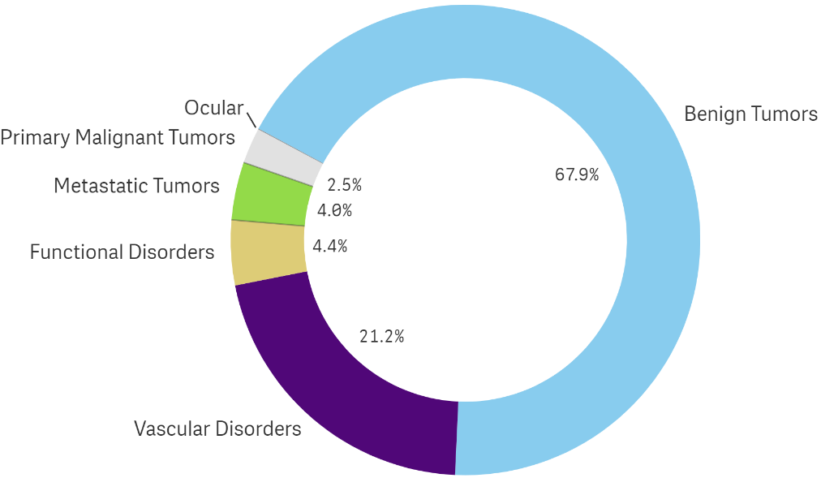
Leksell Gamma Knife® CASE MIX, INDIA
1997 - 2021
2021

Slide 44
Leksell Gamma Knife® OVER 293 000 TREATMENTS REPORTED THROUGH 2021, JAPAN

Slide 45
Leksell Gamma Knife® CASE MIX, JAPAN
1991 - 2021
2021

Slide 46
Leksell Gamma Knife® OVER 87 000 TREATMENTS REPORTED THROUGH 2021, REPLUBLIC OF KOREA

Slide 47
Leksell Gamma Knife® CASE MIX, REPUBLIC OF KOREA
1991 - 2021
2021

Slide 48
EUROPE

Slide 49
Leksell Gamma Knife® OVER 336 000 TREATMENTS REPORTED THROUGH 2021, EUROPE

Slide 50
Leksell Gamma Knife® INDICATIONS REPORTED ANNUALLY, EUROPE

Slide 51
Leksell Gamma Knife® INDICATIONS REPORTED 1968 – 2021, EUROPE

Slide 52
Leksell Gamma Knife® INDICATIONS REPORTED 2021, EUROPE

Slide 53
Leksell Gamma Knife® OVER 42 000 TREATMENTS REPORTED THROUGH 2021, ITALY

Slide 54
Leksell Gamma Knife® CASE MIX, ITALY
1991 - 2021
2021

Slide 55
Leksell Gamma Knife® OVER 32 000 TREATMENTS REPORTED THROUGH 2021, RUSSIA

Slide 56
Leksell Gamma Knife® CASE MIX, RUSSIA
2005 - 2021
2021

Slide 57
Leksell Gamma Knife® OVER 44 000 TREATMENTS REPORTED THROUGH 2021, TURKEY

Slide 58
Leksell Gamma Knife® CASE MIX, TURKEY
1997 - 2021
2021

Slide 59
Leksell Gamma Knife® OVER 35 000 TREATMENTS REPORTED THROUGH 2021, UNITED KINGDOM

Slide 60
Leksell Gamma Knife® CASE MIX, UNITED KINGDOM
1991 - 2021
2021

Slide 61
MIDDLE EAST & AFRICA

Slide 62
Leksell Gamma Knife® OVER 38 000 TREATMENTS REPORTED THROUGH 2021, MIDDLE EAST & AFRICA

Slide 63
Leksell Gamma Knife® INDICATIONS REPORTED ANNUALLY, MIDDLE EAST & AFRICA
LEGED

Slide 64
Leksell Gamma Knife® INDICATIONS REPORTED 1996 – 2021, MIDDLE EAST & AFRICA

Slide 65
Leksell Gamma Knife® INDICATIONS REPORTED 2021, MIDDLE EAST & AFRICA

Slide 66
THE AMERICAS

Slide 67
Leksell Gamma Knife® OVER 367 000 TREATMENTS REPORTED THROUGH 2021, THE AMERICAS

Slide 68
Leksell Gamma Knife® INDICATIONS REPORTED ANNUALLY, THE AMERICAS

Slide 69
Leksell Gamma Knife® INDICATIONS REPORTED 1987 – 2021, THE AMERICAS

Slide 70
Leksell Gamma Knife® INDICATIONS REPORTED 2021, THE AMERICAS
This one plus 69, 73, 74

Slide 71
Leksell Gamma Knife® OVER 21 000 TREATMENTS REPORTED THROUGH 2021, CANADA

Slide 72
Leksell Gamma Knife® CASE MIX, CANADA
2003 - 2021
2021

Slide 73
Leksell Gamma Knife® OVER 331 000 TREATMENTS REPORTED THROUGH 2021, UNITED STATES

Slide 74
Leksell Gamma Knife® CASE MIX, UNITED STATES
1987 - 2021
2021

Slide 75
LEKSELL GAMMA KNIFE® SOCIETY
Mission Statement
To further define and expand the role of Gamma Knife Surgery in the treatment of intracranial disorders. The development of best practices in order to improve patient outcomes is an important objective of the Society.
Online Member Registration lgksociety.com
Exclusive access to many events, education, library of materials, research and articles, news, and the members’ corner – available for current staff practicing at a Gamma Knife center.
Contact the Secretariat info@lgksociety.com
Please reference “Courtesy of the Leksell Gamma Knife® Society” when using or distributing the data in this presentation and do not hesitate to contact the Secretariat for questions.
Interested in more detailed data? We are happy to work with you to provide slides for presentations within the boundaries we have set for data privacy.

Slide 76
How to copy a PowerPoint slide without losing formatting
Select the slide(s) you want to copy from the Slides pane.
Press Ctrl + C (or right-click and select "Copy").
Right-click in the Slides pane of the Powerpoint where you want to paste the copied slide(s) and select "Keep Source Formatting" from the Paste Options menu.
By choosing "Keep Source Formatting", the copied slide will retain its original formatting, including fonts, colors, and graphics.
Step 3, highlighted “Keep Source Formatting” icon
Example Step 1
Slides 5, 8, 9 chosen

